Slide 1


Week 2: Measuring and comparing biodiversity
Roel van Klink (roel.klink@idiv.de)
Emma Ladouceur (Emma.Ladouceur@idiv.de)

Slide 2


This week
Monday: lecture and practical - biodiversity gradients and scales (Roel van Klink)
Tuesday: lecture and computer practical – biodiversity metrics (Kim Thompson)
Wednesday: computer practical and start mini projects (Alban Sagouis, and others)
Thursday: work on mini projects (office hours of instructors on Github)
Friday: morning: work on mini projects
afternoon: presenting mini projects (instructions on Github)
Alban Sagouis
Kim Thompson

Slide 3
Today
10:00 - 10:30 recap and discussion on sampling trees
10:30 - 12:00 Lecture: measuring and comparing biodiversity
13:00 - 15:30 Practical comparing biodiversity across scales (with candy)
Roel van Klink (roel.klink@idiv.de)

Slide 4
Learning objectives
The difficulties of measuring biodiversity
Particularly with reference to scale
Some ways to deal with these difficulties

Slide 5
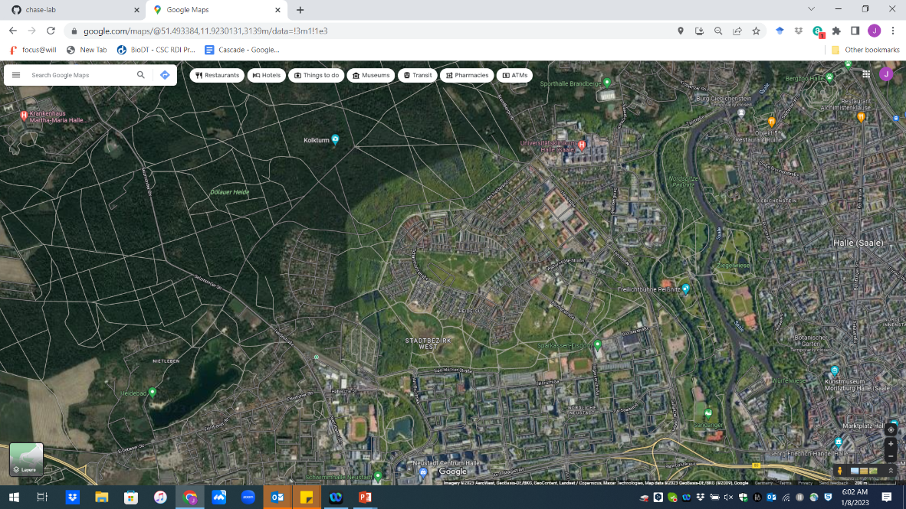

Slide 6
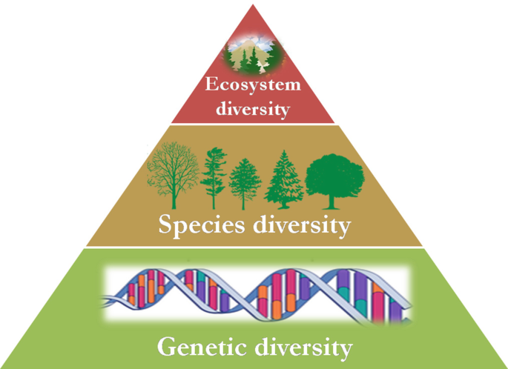
What is biodiversity?
- Focus today on species numbers (sounds easy, but is not)
- Tomorrow other measures of biodiversity.

Slide 7
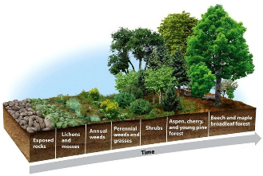
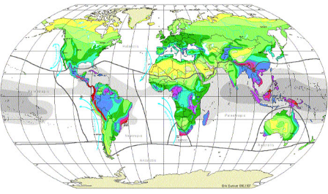
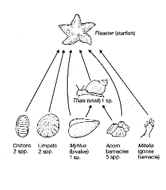
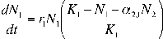
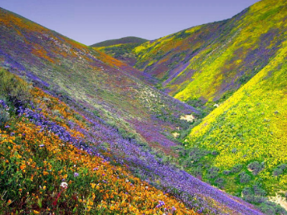
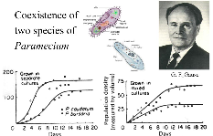
Process→Pattern
Pattern→Process
Notes:
Ecology vs macro-ecology

Slide 8
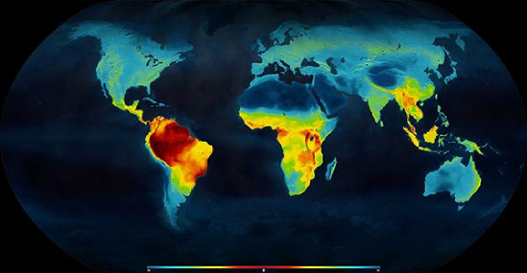
Part 1. Biodiversity gradients

Slide 9
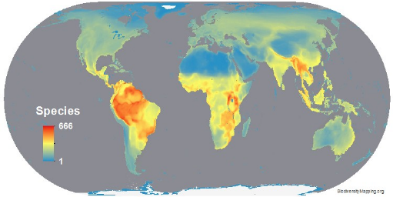
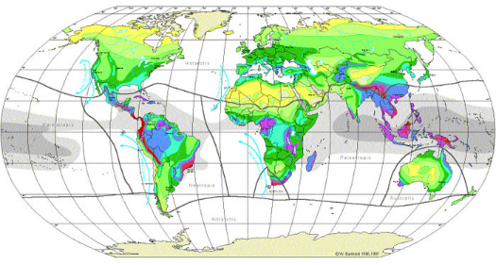
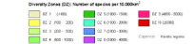
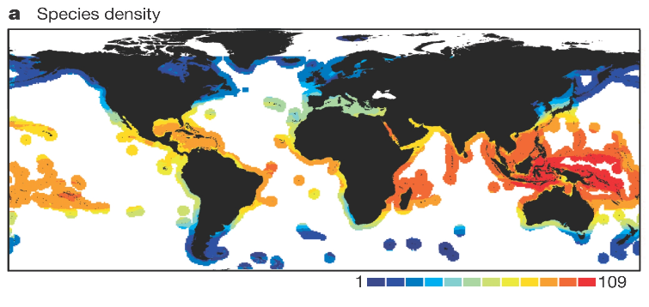
Bird Diversity
Vascular Plants
Marine Fishes
Notes:
What do you see here? Latitude, mountain ranges rain forest, cral reefs

Slide 10
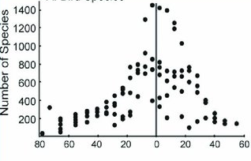
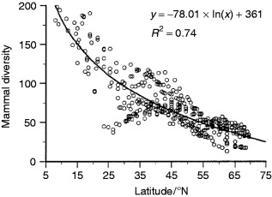
Latitude

Slide 11
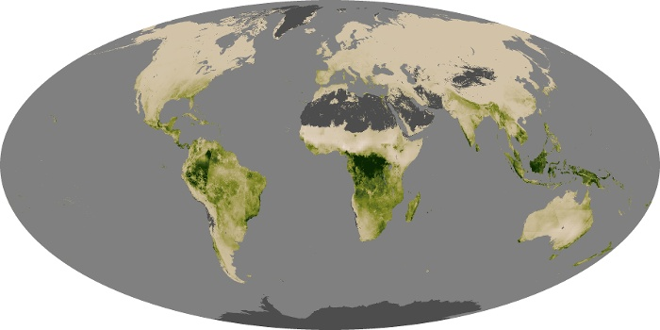
Why Latitude?
Area
Energy
Climate (stability/harshness)
Historical Biogeography:
-repeated disturbance
-evolutionary speed
More biotic interactions
Global Net Productivity—NASA Observatory
Notes:
Hypothesised mechanisms

Slide 12
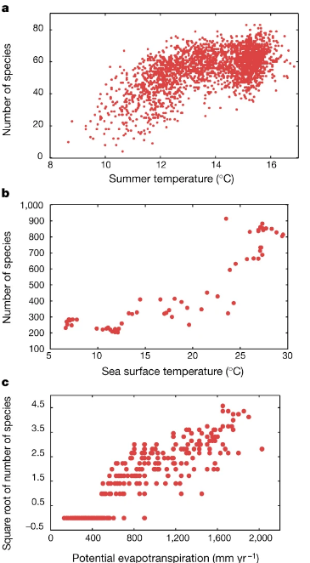
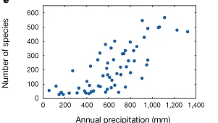
Precipitation, Energy, Temperature gradients

Slide 13
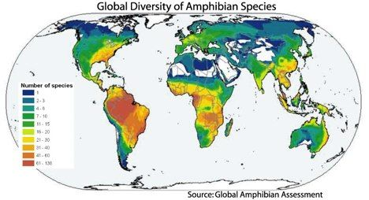
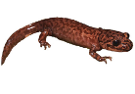
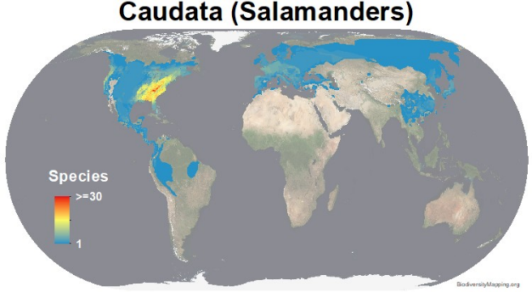
Taxonomic scale matters
Notes:
Taxon dependent

Slide 14
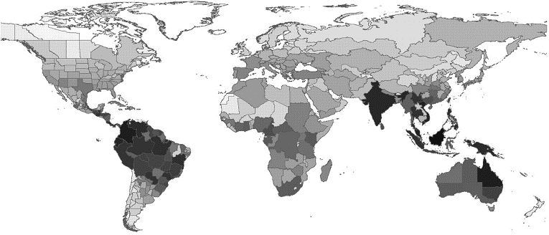
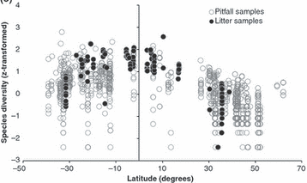
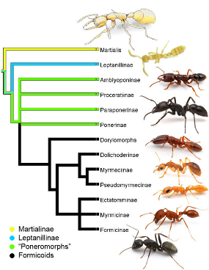
Biogeography matters
Dunn et al. 2009, Ecology Letters
Notes:
Biogeograpy and historical contingency

Slide 15
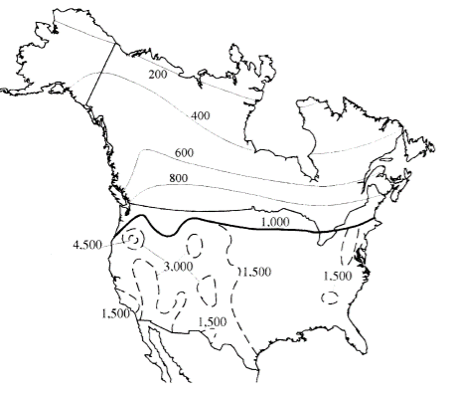
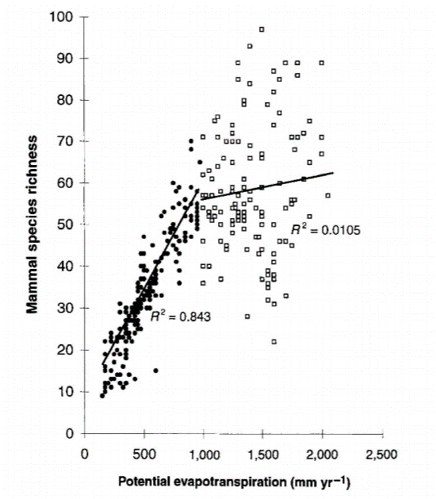
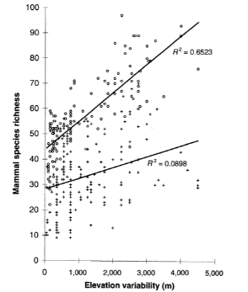
Habitat heterogeneity matters
Kerr and Packer 1997, Nature

Slide 16
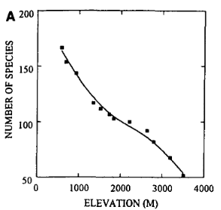
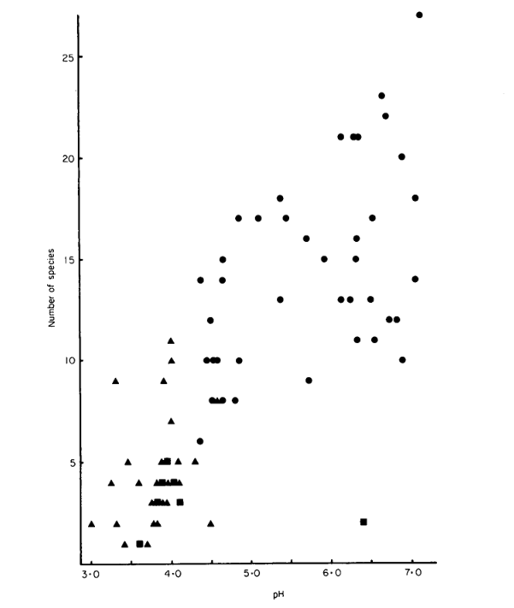
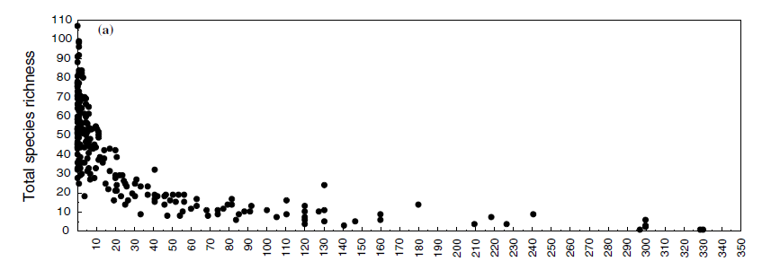
Other biodiversity gradients
Diversity gradients
Altitude
Salinity
Drought
pH
Etc…
pH
Crustacean diversity (Fryer 1980 Freshw biol)
Rahbek 1995 Ecography
Distance from stream
Salinity
Invertebrates in the Antarctic dry desert (Treonis et al 1999 Ecosystems)
Freshwater invertebrates in saline ponds (Pinder et al 2005 Hydrobiol)

Slide 17

Part 2. Measuring biodiversity

Slide 18
Notes:
We want to measure the biodiversity of this place, focusing first on the number of species. How do we do this?

Slide 19
Random
Notes:
Obviously impossible to measure every single individual

Slide 20
Regular grid
Sampling…

Slide 21
Stratified random sampling
Notes:
Obviously impossible to measure every single individual

Slide 22
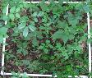
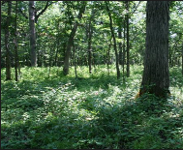
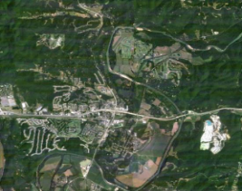
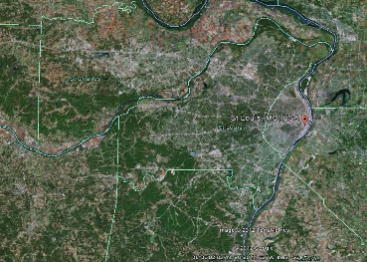
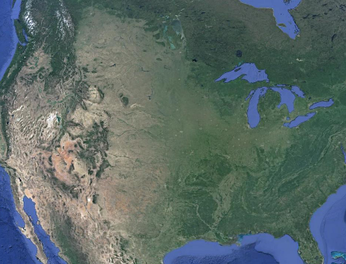
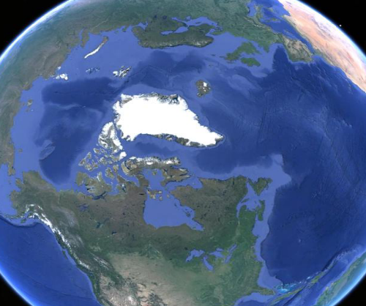
Biodiversity Scaling—

Slide 23
Sampling and Scale
A community
Species Area Curve
Species Accumulation Curve
Species Area Relationship
10
Species Richness
8
6
4
2
0
0 30 60 90 120 150 180
Area Sampled/
Number of individuals

Slide 24
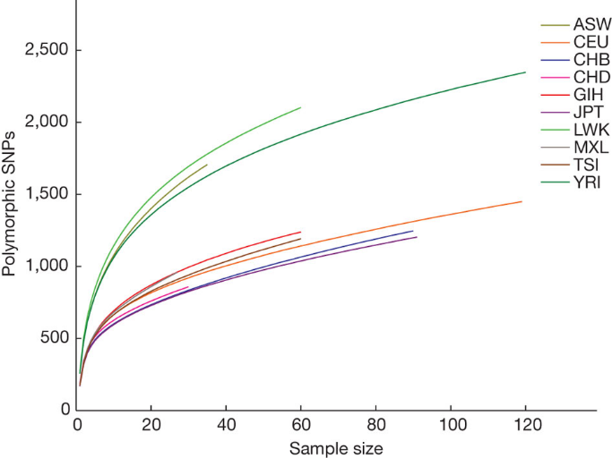
This problem is not unique to ecology

Slide 25
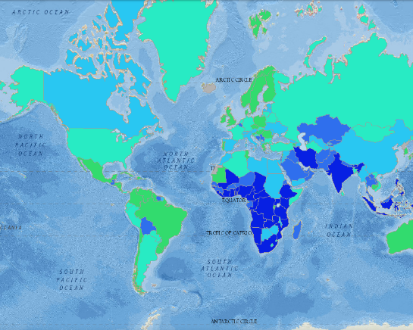
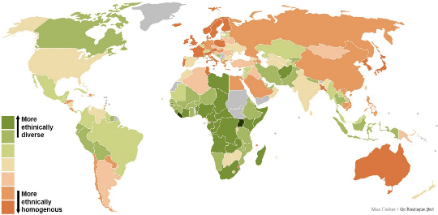
Other kinds of diversity—Ethnic, Language, etc

Slide 26
Candy lab 1
Species accumulation exercise (see github readme):
Open google spreadsheet.
Draw individuals randomly from the bag, one at a time, and note the 'species' in the sheet for your group. You may eat the candy, but there will be a lot more candy this afternoon!
See the species accumulation curve develop for each bag.
Discussion: What community properties determine the shape of the curve?

Slide 27
Sampling and Scale
A community
Species Area Curve
Species Accumulation Curve
Species Area Relationship
10
Species Richness
8
6
4
2
0
0 30 60 90
Area Sampled/
Number of individuals

Slide 28
Different Kinds of Species Area Relationships (SARs)
Nested
Scheiner 2003

Slide 29
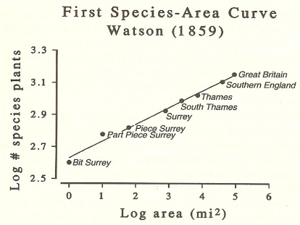
Preston 1960

Slide 30
Different Kinds of Species Area Relationships (SARs)
Regular grid
Scheiner 2003

Slide 31
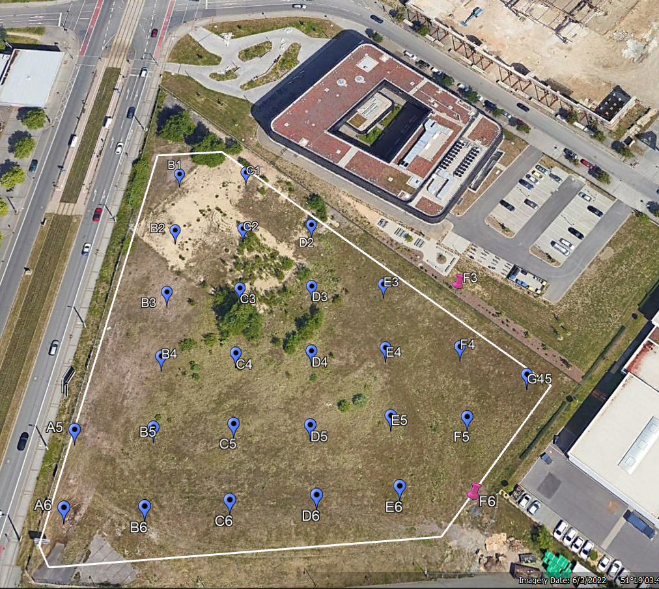
iDiv

Slide 32
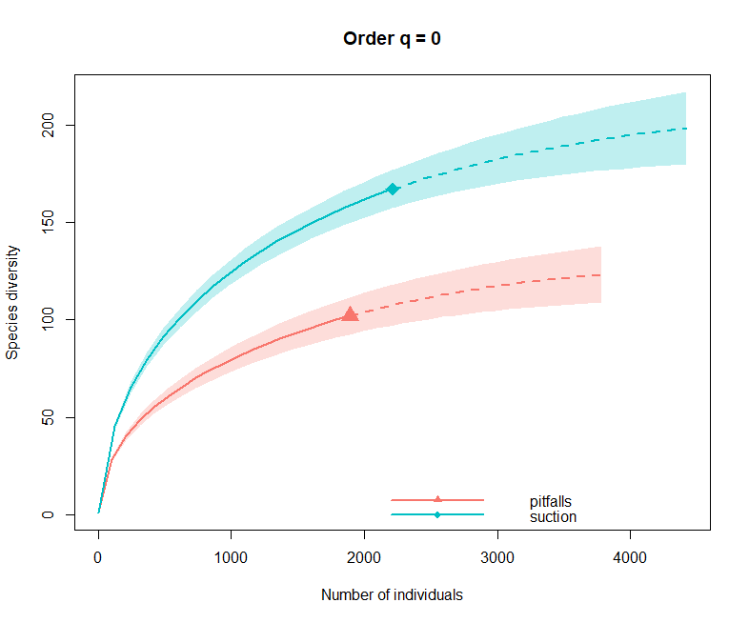

Slide 33
Different Kinds of Species Area Relationships (SARs)
Island Species Area Relationship (ISAR)
Scheiner 2003

Slide 34
Near Mainland
Far from Mainland
MacArthur and Wilson 1963

Slide 35
Mechanisms behind the Species Area Relationship / species accumulation curve
Notes:
What explains this ubiquitous pattern of the species/are relationship?

Slide 36
Mechanisms behind the Species Area Relationship / species accumulation curve
Sampling (each sample has a limited size and thus not all species can be present in each sample)
Unequal abundances of species (most species are rare, and will only be found with high effort, only few species are common)
Habitat heterogeneity (new habitats with new species are encountered with increased sampling effort)
Clumped occurrence of species (can be stochastic or biological)
Competition (competitive displacement)
Dispersal (or lack of dispersal)
Total available habitat area (island systems!)

Slide 37
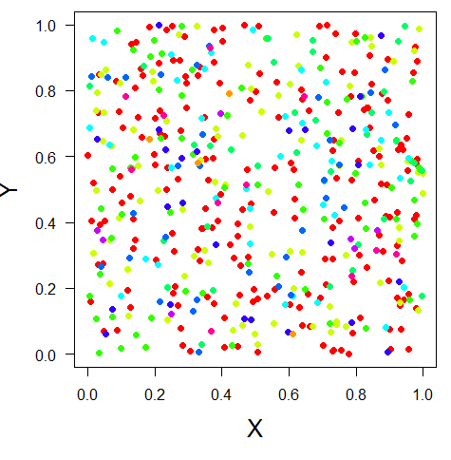
Any measure of diversity only captures part of the picture
α, richness, evenness, diversity entropy
β, similarity, distance decay
γ, SAR, EAR, etc
Notes:
Not sure about this one

Slide 38
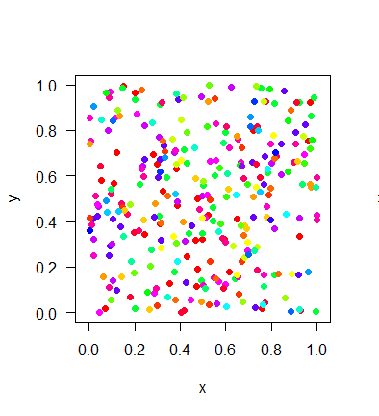
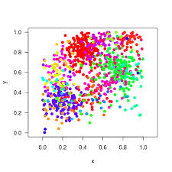
Scale-dependence is inevitable….
Species Richness
Sampling Effort
Species-Area Curve (many types)
Species Accumulation Curve
Rarefaction Curve

Slide 39
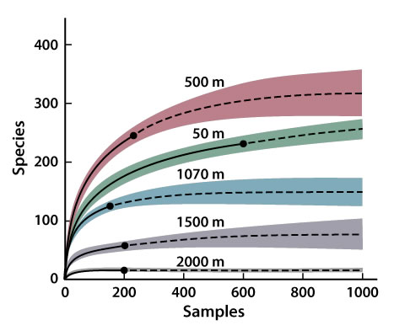
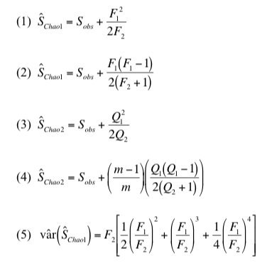
Species Richness Estimators: what is the ‘True’ species richness?
Elevational gradient
Work from Anne Chao and others
Notes:
estimators

Slide 40
Some solutions for dealing with scale dependence
‘Coverage’ richness
Rarefied richness
Sampling coverage, for example 80% completeness
Sampling extent
Number of species
Many solutions, all make improbable assumptions at some scale
Area, samples, or individuals
Notes:
Coverage richness and rarefied richness

Slide 41
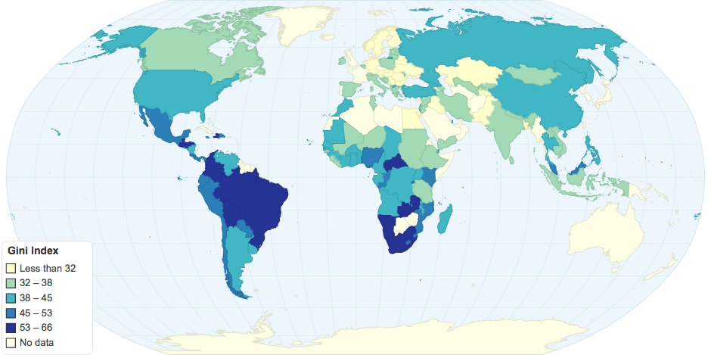
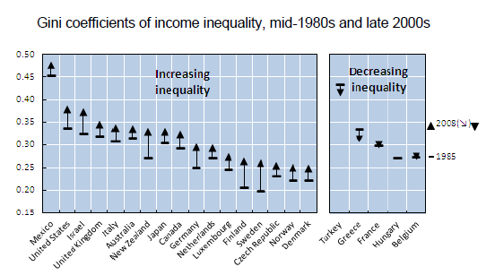
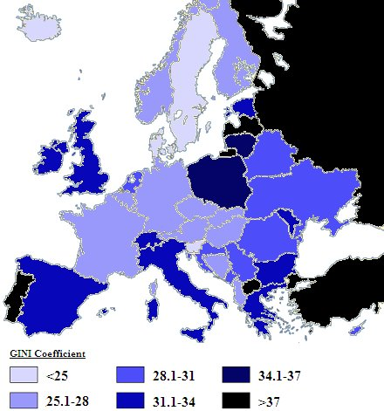
Economics has been doing something similar for some time (Gini Coefficient)
Notes:
Not sure about this one. Is more about equality/ evenness

Slide 42


Other ways of visualizing a community
Species accumulation curve
Species Abundance Distribution
Rank abundance curve
10
8
6
4
2
0
0 30 60 90
Number of individuals
Per species
Per species
Abundance
Richness

Slide 43
Part 3. Comparing biodiversity
Importance of scale for measuring and comparing biodiversity

Slide 44
Sampling and Scale
(more/fewer individuals)
Degraded Community
Pristine Community
Small Effect
Large effect
10
Species Richness
8
6
4
2
0
0 30 60 90 120 150 180
Area Sampled
Chase and Knight 2013 Ecology Letters

Slide 45
Scale and Diversity: An example….
Germany vs. USA
….in BEER!!
Leipzig has good beer….but its diversity is low
-iDiv visitor from the U.S.

Slide 46









German beer is lower in diversity than the U.S…..Really?

Slide 47

Need a fair comparison---rarefaction

Slide 48


Leipzig has good beer….but diversity is low
Grain—
what is the scale in which data are aggregated?
Extent—
What is the scale of comparison?

Slide 49
Biodiversity is fundamentally scale (grain, extent) dependent
Grain
Extent

Slide 50

3.5
3.0
2.5
2.0
1.5
1.0
0.5
0
Log Number of beer types
Pub
City
State
Country (rarefied)
Country
Scale of observation (grain/extent)

Slide 51

Scale-Dependence is the Rule
Small-scale Observations Often Overestimate Effects at Larger Scales
Chase et al. 2018, Ecol. Lett.

Slide 52

Small-scale Observations Often Overestimate Effects at Larger Scales

Slide 53
Wrap-up
Major gradients in biodiversity
The difficulties of measuring biodiversity
Scale of measurement
Comparing biodiversity across scales
Small-scale observations often overestimate biodiversity loss at larges scales.

Slide 54
Tree data comparison

Slide 56




Can’t we just correct for area?
Number of species per area
Large island
Medium island
Number of Species
Small island
Area sampled

Slide 57


The classical Species Area Relationship (SAR) equation
$$S=cA^{z}$$
$$logS=logc{+ z logA}^{}$$
z (slope)
c (intercept)

Slide 58






Aren’t consistent sampling schemes enough?
Unfortunately, no….
CTFS-SGIEO Forest Plots
NutNet Forest Plots

Slide 59


Slide 60



Scale-Dependent Biodiversity Change
Number of Species
Public Domain, https://commons.wikimedia.org/w/index.php?curid=362363
~1700
1850
1950
~Today
Year
Data from: Knapp, S., et al. 2016. Increasing species richness but decreasing phylogenetic richness and divergence over a 320‐year period of urbanization. Journal of Applied Ecology. doi:10.1111/1365-2664.12826
Reprinted by permission from Macmillan Publishers Ltd: Newbold, T., et al. 2015. Global effects of land use on local terrestrial biodiversity. Nature, 520: 45-50.

Slide 61




Homogenization or Differentiation

Slide 62

Biodiversity change—Scale matters
Theoretical Expectations
Meta-analytical results (plants only)

Slide 63
SAR principles can be used to predict extinctions

Slide 64

From MacArthur and Wilson 1967

Slide 65
Island biogeography and extinctions
Koh and Ghazoul 2010

Slide 66






Scale-dependence of invasive species impacts
2.0
R²=0.995, P<0.001
R²=0.978, P=0.001
1.5
Log(Species Richness)
1.0
Uninvaded
Invaded
0.5
0
1
2
3
Log(Area)

Slide 67

Horvath et al. 2019

Slide 68

Horvath et al. 2019

Slide 69




Slide 70



Garbage in….
…Garbage out

Slide 71
Solutions are not as easy as they might seem…
Extrapolations and interpolations are still strongly biased by sample grain/extent
Partitioning of scales (e.g., α-diversity, β-diversity, γ-diversity) doesn’t account for non-linearities
Explicit scaling exponents (e.g., species-accumulations, species-area relationships) are confounded by multiple factors

Slide 72


.. we already have a way to deal with scale…β-diversity
α β = γ
β = γ/α
γ-diversity (21)
10
3
α-diversity
4
11
= 21 / 7
= 3
5
9
α-diversity
β-diversity is a scalar from local (α) to regional (γ)

Slide 73
β-diversity is also complicated
γ-diversity
β-diversity
Diversity
α-diversity
Local Regional
Spatial Scale
Linearization of an inherently non-linear pattern
Shape determined by several distinct components that underlie SAC
Critically grain and extent dependent

Slide 74
Sample Grain and Extent drive β-diversity
Larger grain/extent
α-diversity
α-diversity
γ-diversity
γ-diversity
β
β
Number of Species
β
β
Area sampled

